Slide 1

[SW372] Applied Data Analysis
Chapter 03. Regression
Dept. of SW Convergence
Sangkeun Park
Image by our-team on Freepik

Slide 2
Slide Update History
Date | Description
2024.03.18 | The first version
2024.03.20 | Entire slides has been supplemented with additional content

Slide 3
Objective
Understanding the characteristics of different regression analyses and when to use them
Choosing Regression Algorithms Appropriately
Understanding Evaluation Methods for Regression

Slide 4
Regression
A mathematical or computational technique used to model the relationship between an independent variable(s) and a dependent variable
The main goal of regression algorithms is
to predict the continuous value of the dependent variable based on the values of the independent variable(s)
to find optimized a regression coefficient number(s) of an independent variable(s) for predicting a dependent variable

Slide 5
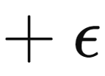
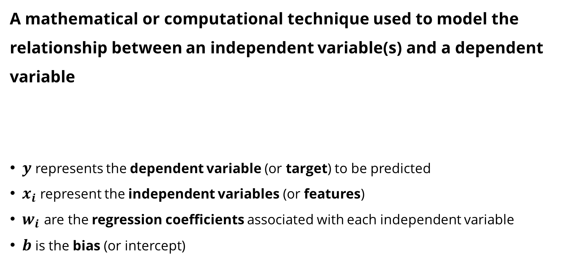
Regression
A mathematical or computational technique used to model the relationship between an independent variable(s) and a dependent variable
$y$ represents the dependent variable (or target) to be predicted
$x_{i}$ represent the independent variables (or features)
$w_{i}$ are the regression coefficients associated with each independent variable
$b$ is the bias (or intercept)

Slide 6
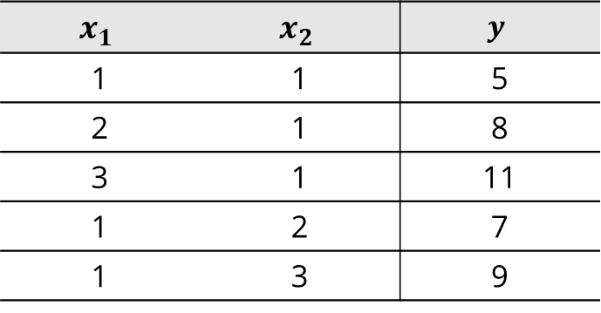

Regression
The effect of coefficients (i.e., $w_{i}$)
When $x_{i}$ is increased by 1 unit, $y$ is increases by the same amount as $w_{i}$
$y$ = 3$x_{1}$ +2$x_{2}$
$$x_{1}$$ | $$x_{2}$$ | $$y$$
1 | 1 | 5
2 | 1 | 8
3 | 1 | 11
1 | 2 | 7
1 | 3 | 9

Slide 7
Regression
(Linear) Regression Algorithms
Linear regression | 선형 회귀
Polynomial regression | 다항 회귀
Ridge regression | 릿지 회귀
Lasso regression | 라쏘 회귀
ElasticNet regression | 엘라스틱넷 회귀

Slide 8
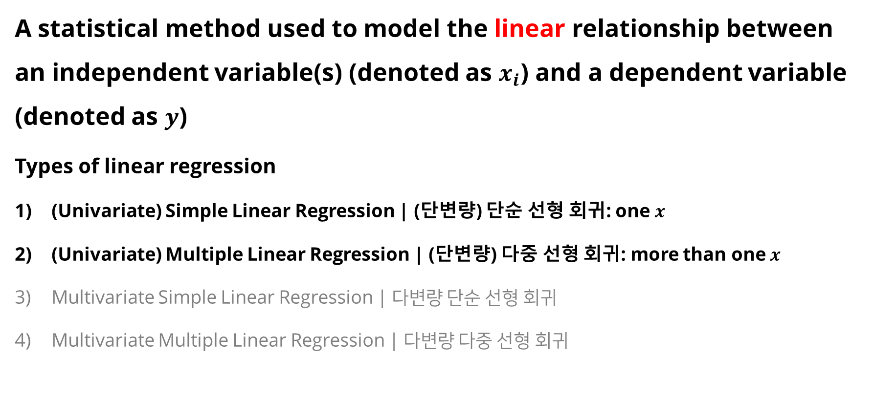
1. Linear Regression
A statistical method used to model the linear relationship between an independent variable(s) (denoted as $x_{i}$) and a dependent variable (denoted as $y$)
Types of linear regression
(Univariate) Simple Linear Regression | (단변량) 단순 선형 회귀: one $x$
(Univariate) Multiple Linear Regression | (단변량) 다중 선형 회귀: more than one $x$
Multivariate Simple Linear Regression | 다변량 단순 선형 회귀
Multivariate Multiple Linear Regression | 다변량 다중 선형 회귀

Slide 9
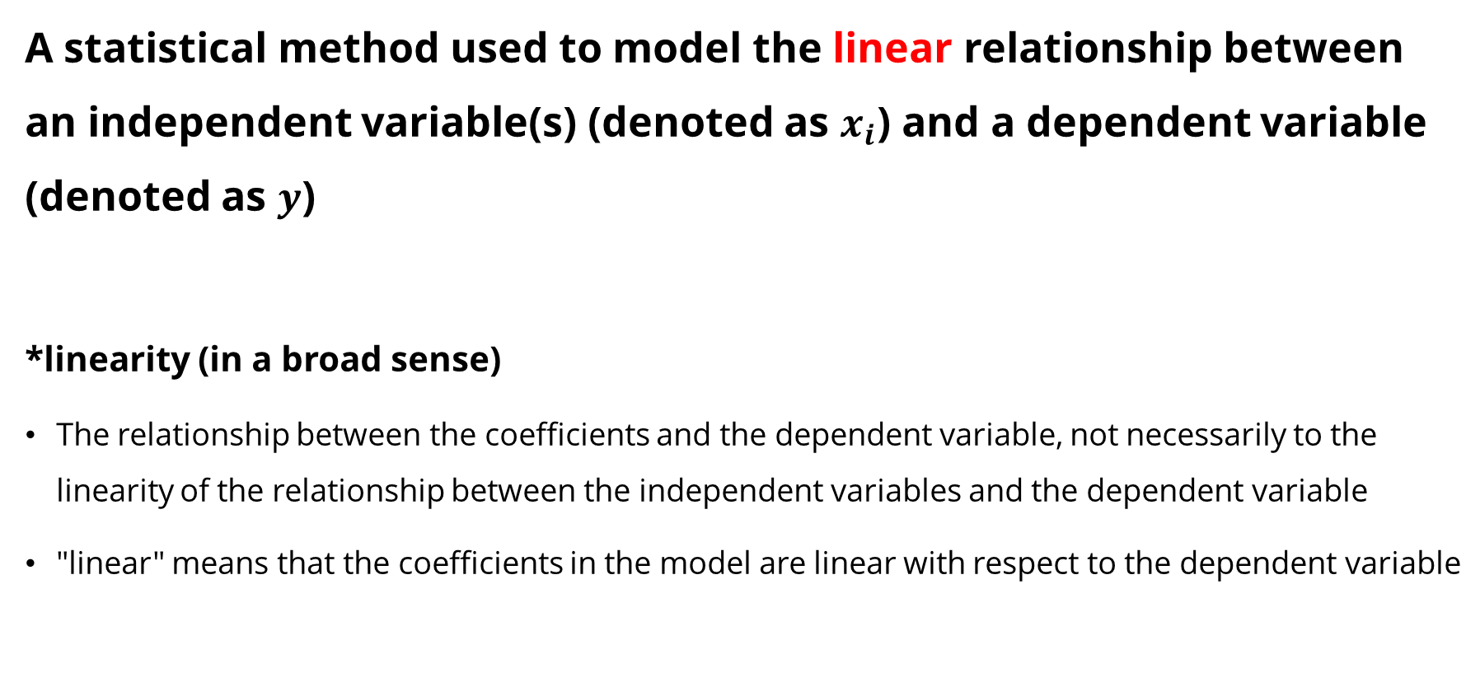
1. Linear Regression
A statistical method used to model the linear relationship between an independent variable(s) (denoted as $x_{i}$) and a dependent variable (denoted as $y$)
*linearity (in a broad sense)
The relationship between the coefficients and the dependent variable, not necessarily to the linearity of the relationship between the independent variables and the dependent variable
"linear" means that the coefficients in the model are linear with respect to the dependent variable

Slide 10

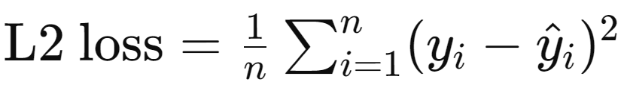
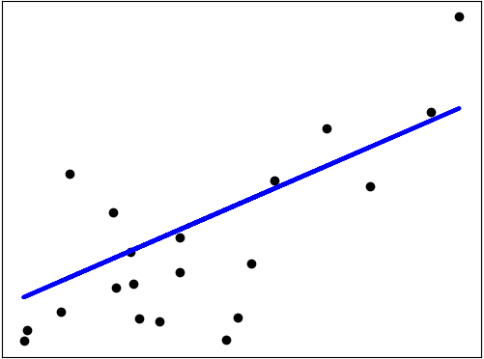
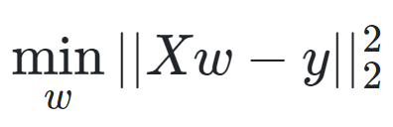
1. Linear Regression
Ordinary Least Squares (OLS)
OLS loss function aims to find the line that best fits the observed value by minimizing the residual sum of squares (RSS) between the observed and predicted values.
Mathematically, it solves a problem of the form:
https://scikit-learn.org/stable/modules/linear_model.html#ordinary-least-squares

Slide 11
Regression Evaluation Metrics
The metrics used to evaluate the performance of regression models
MAE (Mean Absolute Error)
MSE (Mean Squared Error)
RMSE (Root Mean Squared Error)
R² (R-squared)

Slide 12
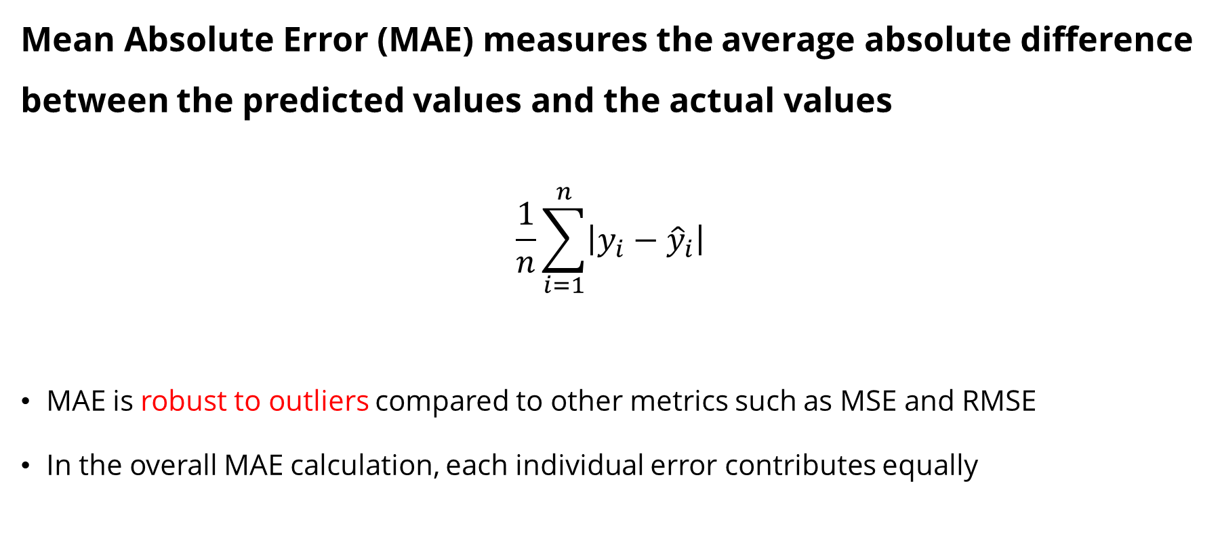
1) MAE
Mean Absolute Error (MAE) measures the average absolute difference between the predicted values and the actual values
$$\frac{1}{n}\sum_{i=1}^{n}{\left|y_{i}−{\hat{y}}_{i}\right|}$$
MAE is robust to outliers compared to other metrics such as MSE and RMSE
In the overall MAE calculation, each individual error contributes equally

Slide 13
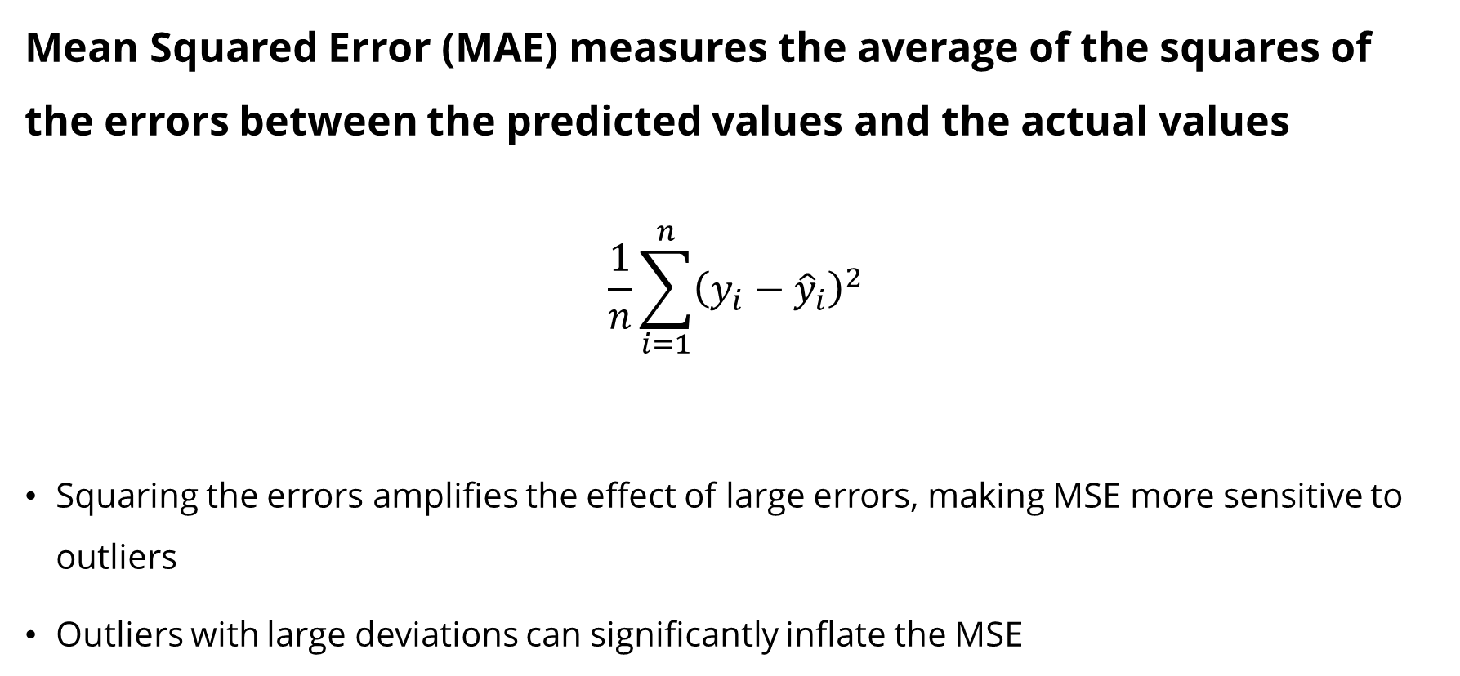
2) MSE
Mean Squared Error (MAE) measures the average of the squares of the errors between the predicted values and the actual values
$$\frac{1}{n}\sum_{i=1}^{n}{{\left(y_{i}−{\hat{y}}_{i}\right)}^{2}}$$
Squaring the errors amplifies the effect of large errors, making MSE more sensitive to outliers
Outliers with large deviations can significantly inflate the MSE

Slide 14
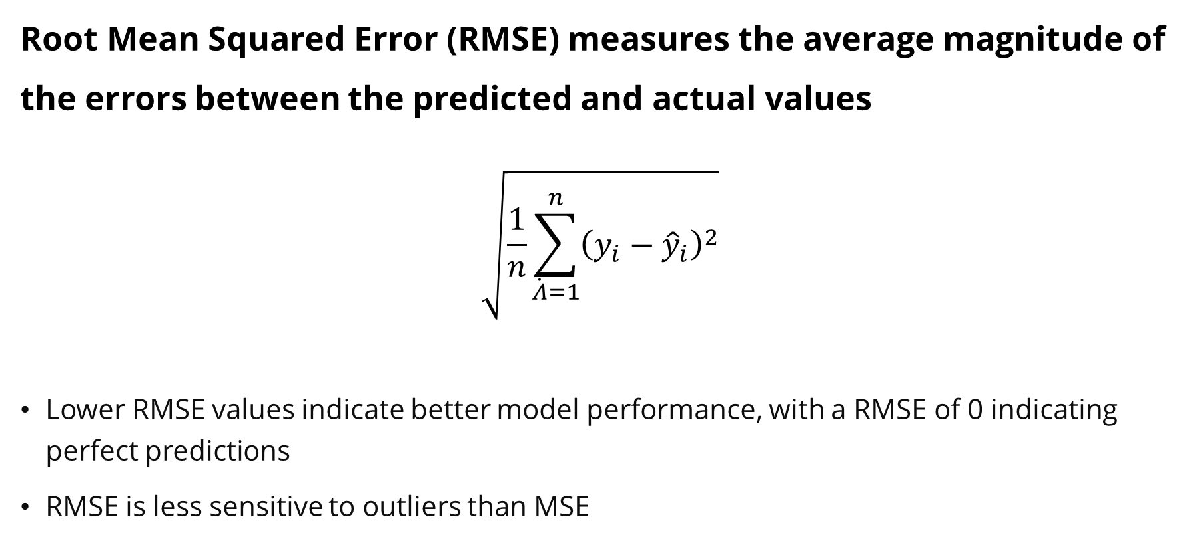
3) RMSE
Root Mean Squared Error (RMSE) measures the average magnitude of the errors between the predicted and actual values
$$\sqrt{\frac{1}{n}\sum_{\dot{Λ}=1}^{n}{{\left(y_{i}−{\hat{y}}_{i}\right)}^{2}}}$$
Lower RMSE values indicate better model performance, with a RMSE of 0 indicating perfect predictions
RMSE is less sensitive to outliers than MSE

Slide 15
03/20 수업

Slide 16
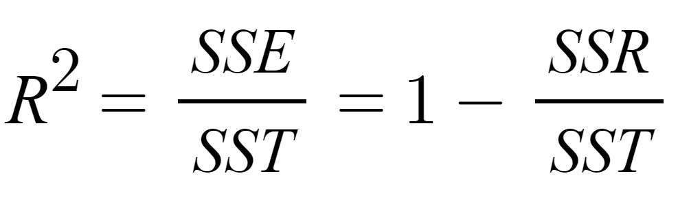
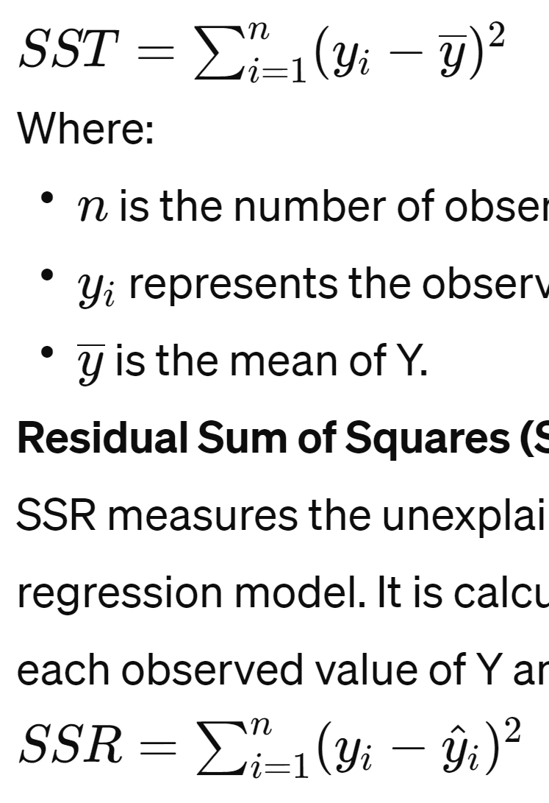

4) R²
R² (R-squared) measure that represents the proportion of the variance in the dependent variable that is predictable from the independent variables in a regression model
SSR(Res) is the sum of the squared differences between each observed value ($y_{i}$) and its predicted value (${\hat{y}}_{i}$)
SST(Total) is the total variability in the observed values ($y_{i}$) around its mean ($\overline{y}$)
SSE(Error) is the sum of the squared differences between each predicted value (${\hat{y}}_{i}$) and mean ($\overline{y}$)
Coming soon
with better examples

Slide 17
4) R²
R² (R-squared) measure that represents the proportion of the variance in the dependent variable that is predictable from the independent variables in a regression model
0 indicates that the model does not explain any of the variability in the dependent variable (bad)
1 indicates that the model explains all of the variability in the dependent variable (good)
Interpretability: R² directly indicates how well the model explains the variability of the dependent variable
Sample Size Correction: R² is less sensitive to changes in sample size compared to others matrics (i.e., MAE, MSE, and RMSE)

Slide 18
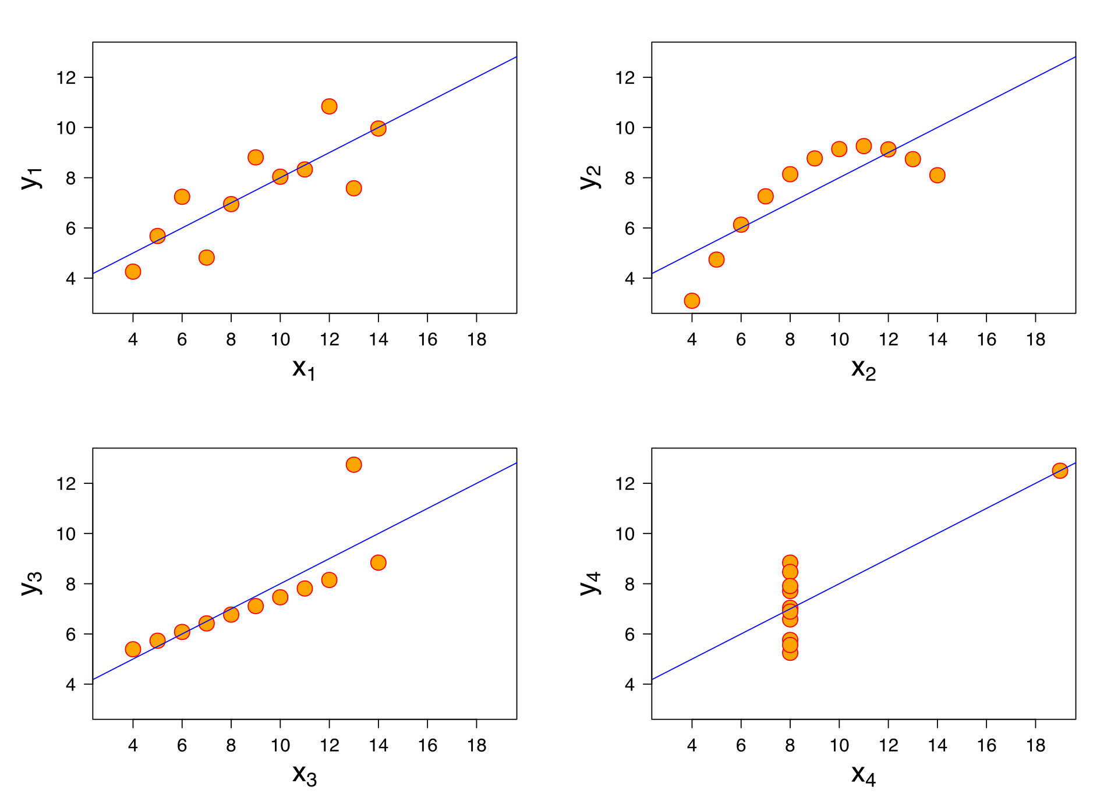
4) R²
Anscombe's quartet
Following four sets have identical statistical parameters, but the graphs show them to be considerably different (Mean x is 9, Mean y is 7.5, R² is 0.67)
4개 데이터셋 통계랑 (평균, 분산) 전부 같고, r^2값도 같음
r^2을 맹신할 수 없다
https://en.wikipedia.org/wiki/Anscombe%27s_quartet

Slide 19
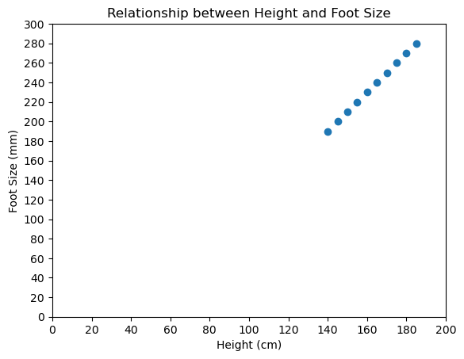
1. Linear Regression

Slide 20
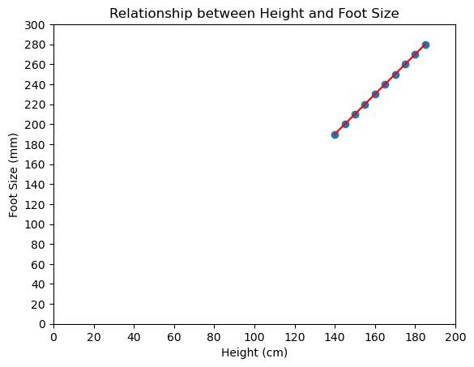

1. Linear Regression
MAE: 0
MSE: 0
RMSE: 0
R²: 1.0
$$y=2x_{1}−90$$

Slide 21
1. Linear Regression
Predicting Sales using Advertising Spending
 | Advertising Spending | Sales
0 | 10 | 50
1 | 20 | 60
2 | 30 | 70
3 | 40 | 80
4 | 50 | 72
5 | 60 | 68
6 | 70 | 65
7 | 80 | 62
8 | 90 | 60
9 | 100 | 58

Slide 22
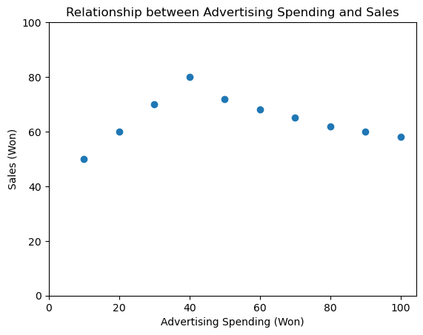
1. Linear Regression
How would you draw a line representing a linear regression here?
Notes:
데이터셋을 나눠서 두개의 regression line을 생성하면 안되나?

Slide 23
1. Linear Regression
How would you draw a line representing a linear regression here?
②
①

Slide 24
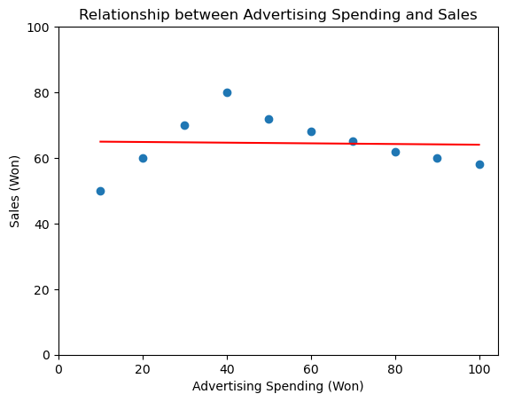
1. Linear Regression
The following red line is the best 😛
MAE: 6.4485
MSE: 63.7624
RMSE: 7.9851
R²: 0.0014

Slide 25
1. Linear Regression
What if we use unnecessary features to predict Sales?
Random number and Garbage numbers are irrelevant to predict the Sales
 | Advertising Spending | Random No. | Garbage No. | Sales
0 | 10 | 999 | 0 | 50
1 | 20 | -99 | -2 | 60
2 | 30 | 999 | 3 | 70
3 | 40 | -99 | 4 | 80
4 | 50 | 999 | -5 | 72
5 | 60 | -99 | 9999 | 68
6 | 70 | 999 | -3 | 65
7 | 80 | -99 | 2 | 62
8 | 90 | 999 | -1 | 60
9 | 100 | -99 | 9999 | 58

Slide 26
1. Linear Regression
What if we use unnecessary features to predict Sales?
Why does MAE increase while MSE and RMSE decrease? 😫
Why does MAE increase while R² increase? 😫
Why does R² increase even when use irrelevant features? 😫
Features | MAE | MSE | RMSE | R²
Advertising Spending | 6.4485 | 63.7624 | 7.9851 | 0.0014
Advertising Spending + Random No. | 6.6500 | 62.3950 | 7.8991 | 0.0228
Advertising Spending + Random No. + Garbage No. | 6.9199 | 60.3727 | 7.7700 | 0.0545
$$y=0.0050x_{1}−0.0036x_{2}−0.0004x_{3}+66.4$$
Mae : Mse는 작아진 이유 : 오차가 1이하이기 때문
독립변수 많아지면 r^2값이 무조건 커짐

Slide 27
1. Linear Regression
What if we use unnecessary features to predict Sales?
Features | MAE | MSE | RMSE | R²
Advertising Spending | 6.4485 | 63.7624 | 7.9851 | 0.0014
Advertising Spending + Random No. | 6.6500 | 62.3950 | 7.8991 | 0.0228
Advertising Spending + Random No. + Garbage No. | 6.9199 | 60.3727 | 7.7700 | 0.0545
Before Standardization
$$y=0.0050x_{1}−0.0036x_{2}−0.0004x_{3}+66.4$$
Features | MAE | MSE | RMSE | R²
Advertising Spending | 6.4485 | 63.7624 | 7.9851 | 0.0014
Advertising Spending + Random No. | 6.6500 | 62.3950 | 7.8991 | 0.0228
Advertising Spending + Random No. + Garbage No. | 6.9199 | 60.3727 | 7.7700 | 0.0545
After Standardization
$$y=0.14304x_{1}−1.9750x_{2}−1.7990x_{3}+64.5$$
계수가 달라짐, mae,mse,rmse,r^2값은 같은 반면

Slide 28
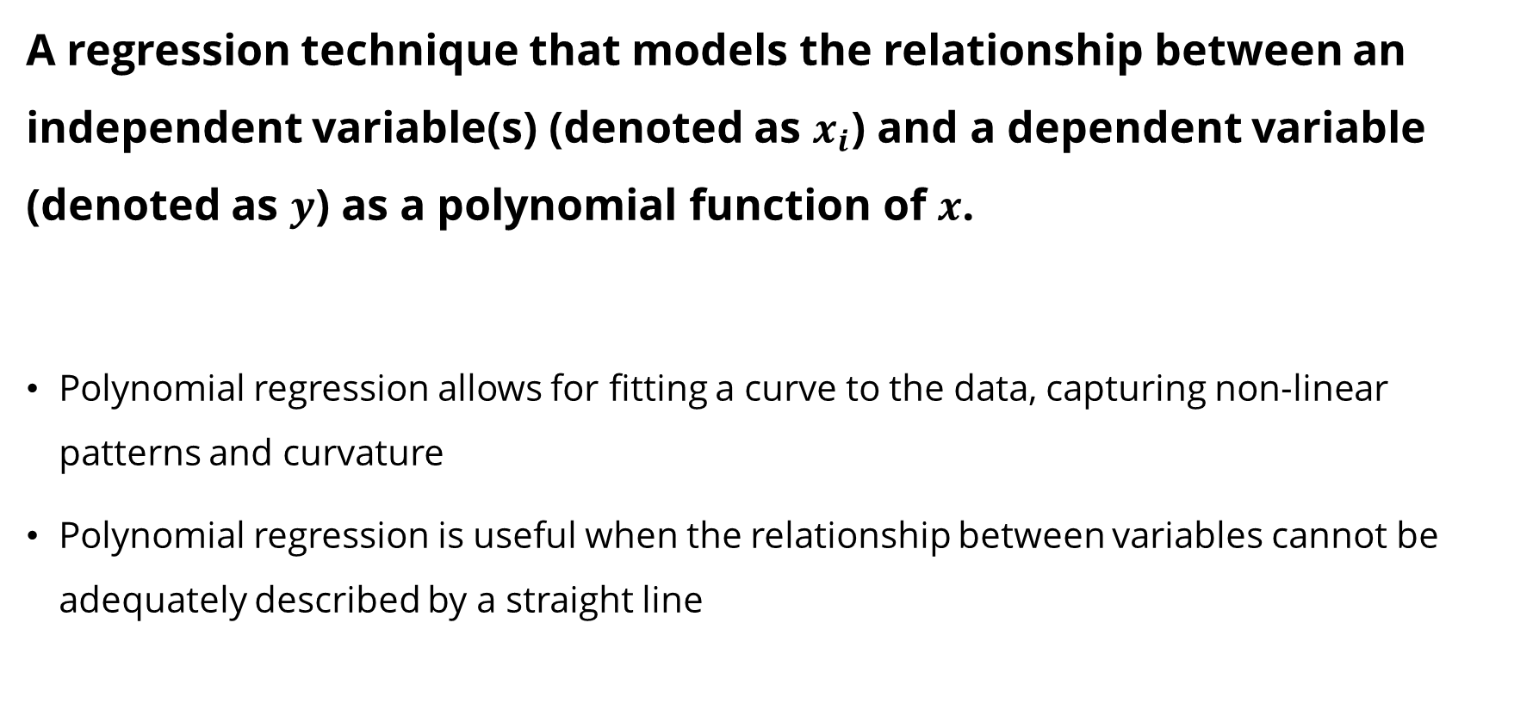
2. Polynomial Regression
A regression technique that models the relationship between an independent variable(s) (denoted as $x_{i}$) and a dependent variable (denoted as $y$) as a polynomial function of $x$.
Polynomial regression allows for fitting a curve to the data, capturing non-linear patterns and curvature
Polynomial regression is useful when the relationship between variables cannot be adequately described by a straight line

Slide 29
2. Polynomial Regression
Predicting Sales using Advertising Spending
 | Advertising Spending | Sales
0 | 10 | 50
1 | 20 | 60
2 | 30 | 70
3 | 40 | 80
4 | 50 | 72
5 | 60 | 68
6 | 70 | 65
7 | 80 | 62
8 | 90 | 60
9 | 100 | 58

Slide 30
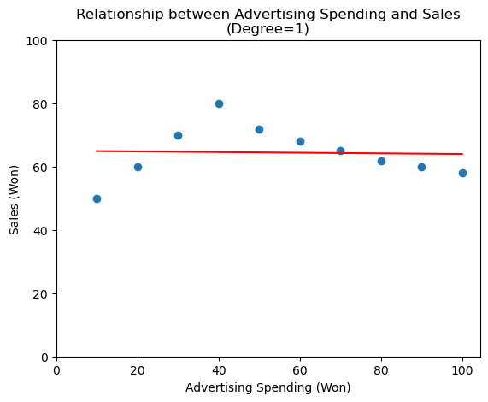
2. Polynomial Regression
MAE: 6.4485
MSE: 63.7624
RMSE: 7.9851
R²: 0.0014

Slide 31
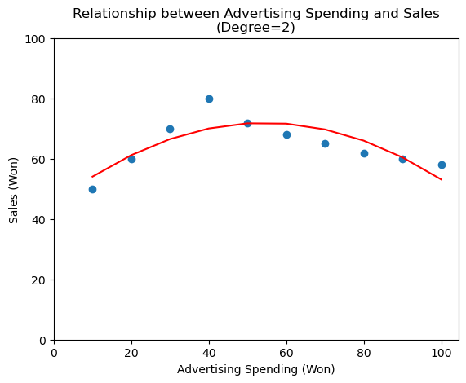
2. Polynomial Regression
$$y=−0.009x_{1}2+{0.986x}_{1}+45.15$$
MAE: 3.6758
MSE: 20.4889
RMSE: 4.5265
R²: 0.6791

Slide 32
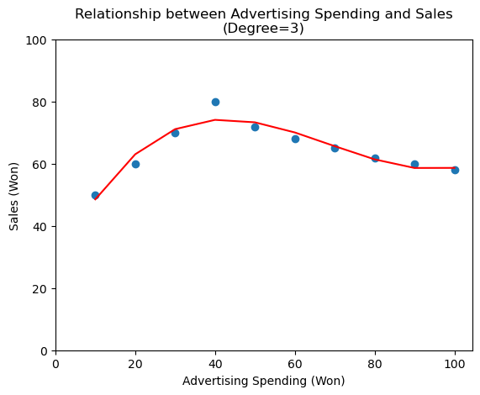
2. Polynomial Regression
$$y=0.0002x_{1}3−0.0452x_{1}2+2.6544x_{1}+0$$
MAE: 1.8275
MSE: 5.633
RMSE: 2.3734
R²: 0.9118

Slide 33
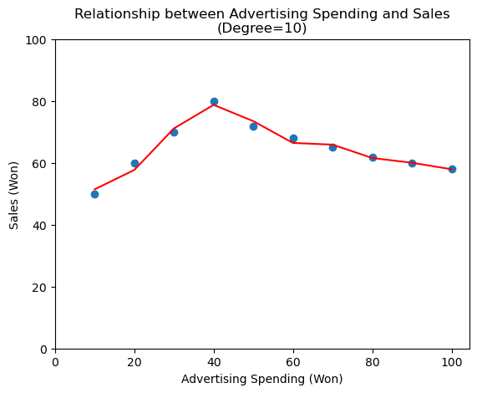
2. Polynomial Regression
MAE: 1.0556
MSE: 1.573
RMSE: 1.2542
R²: 0.9754

Slide 34
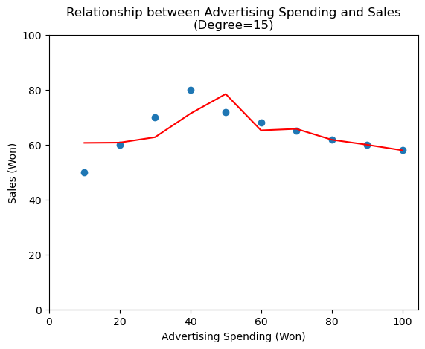
2. Polynomial Regression
The higher degree does not necessarily ensure better performance 😛
MAE: 3.763
MSE: 29.2886
RMSE: 5.4119
R²: 0.5413

Slide 35
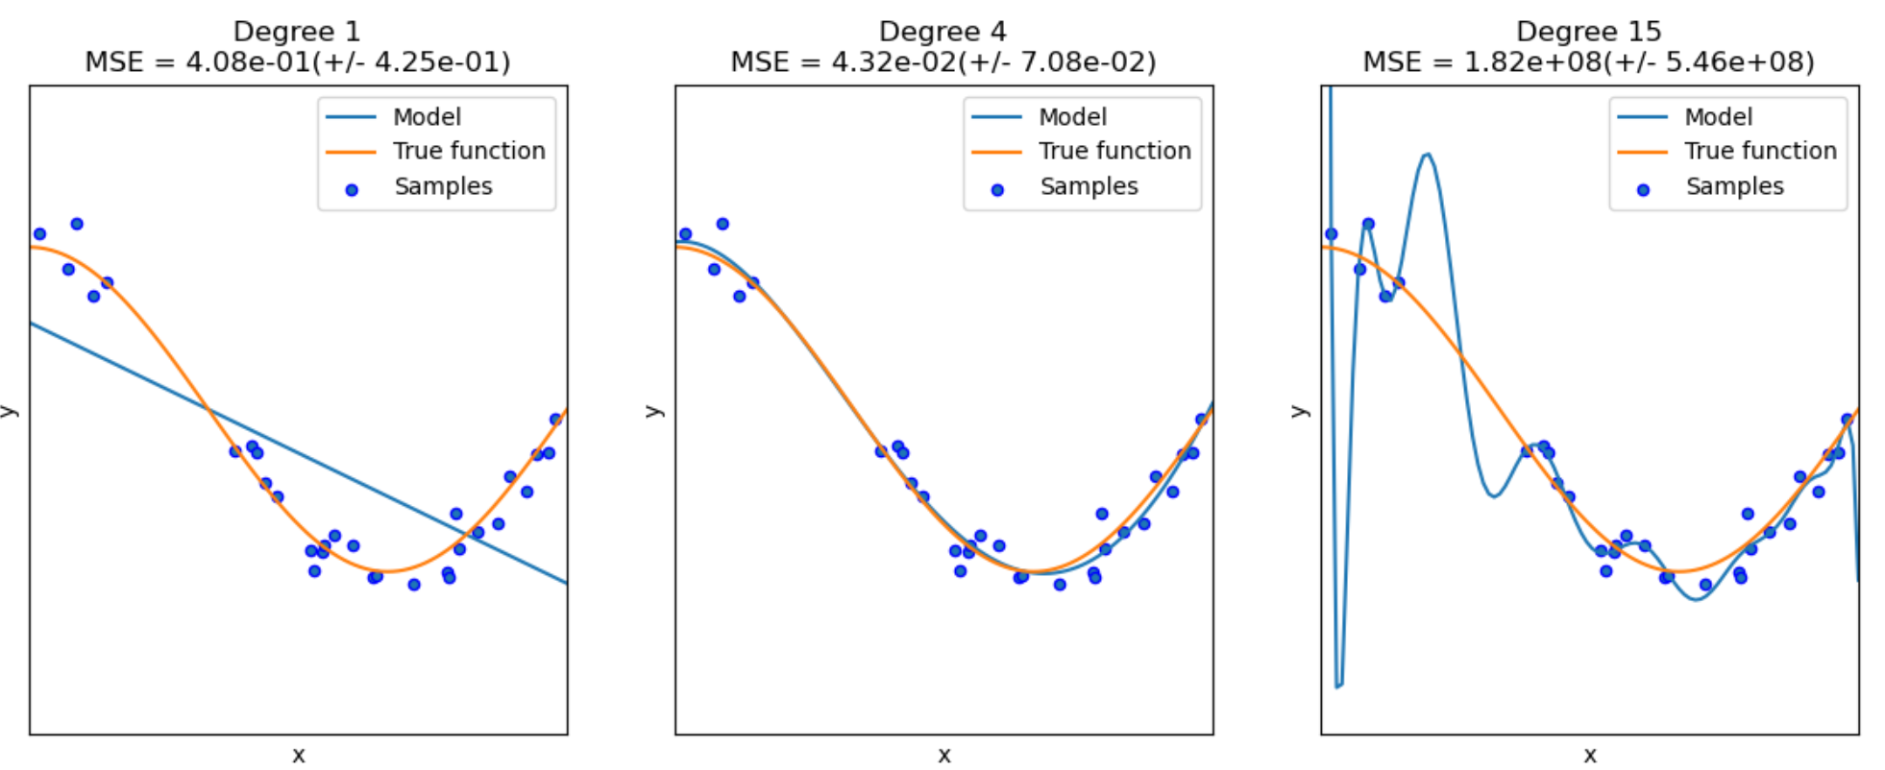
2. Polynomial Regression
Underfitting and Overfitting
https://scikit-learn.org/stable/auto_examples/model_selection/plot_underfitting_overfitting.html

Slide 36
2. Polynomial Regression
What if we use unnecessary features to predict Sales?
Random number and Garbage numbers are irrelevant to predict the Sales
 | Advertising Spending | Random No. | Garbage No. | Sales
0 | 10 | 999 | 0 | 50
1 | 20 | -99 | -2 | 60
2 | 30 | 999 | 3 | 70
3 | 40 | -99 | 4 | 80
4 | 50 | 999 | -5 | 72
5 | 60 | -99 | 9999 | 68
6 | 70 | 999 | -3 | 65
7 | 80 | -99 | 2 | 62
8 | 90 | 999 | -1 | 60
9 | 100 | -99 | 9999 | 58

Slide 37
2. Polynomial Regression
What if we use unnecessary features to predict Sales?
Degree | MAE | MSE | RMSE | R²
1 | 6.9199 | 60.3727 | 7.7700 | 0.0545
2 | 0.8949 | 2.2796 | 1.5098 | 0.9643
3 | 0.0 | 0.0 | 0.0 | 1.0
10 | 2.5334 | 24.2667 | 4.9261 | 0.6199
15 | 5.8945 | 55.3986 | 7.4430 | 0.1324
20 | 5.5000 | 58.2875 | 7.6346 | 0.0871
100 | Error: infinity or a value too large
Degree | MAE | MSE | RMSE | R²
1 | 6.9199 | 60.3727 | 7.77 | 0.0545
2 | 0.8949 | 2.2796 | 1.5098 | 0.9643
3 | 0.0 | 0.0 | 0.0 | 1.0
10 | 0.0 | 0.0 | 0.0 | 1.0
15 | 0.0 | 0.0 | 0.0 | 1.0
20 | 0.0 | 0.0 | 0.0 | 1.0
100 | 4.2 | 33.0 | 5.7446 | 0.4832
Before Standardization
After Standardization

Slide 38
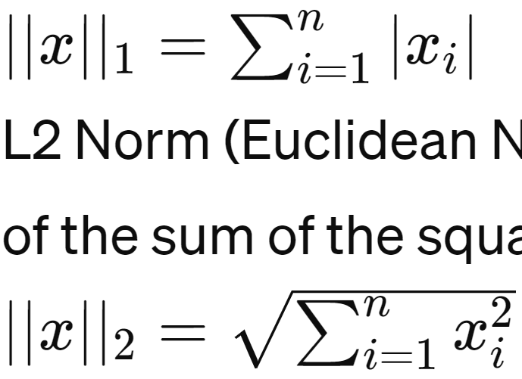
Norm
Norm
A norm is a function that assigns a strictly positive length, size, or distance to each vector in a vector space (except for the zero vector)
L1 Norm (Manhattan Norm)
This norm is defined as the sum of the absolute values of the vector components.
L2 Norm (Euclidean Norm)
This norm is defined as the square root of the sum of the squares of the vector components.

Slide 39
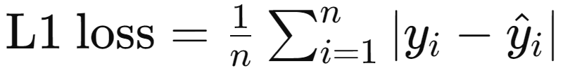
1) L1 Norm
L1 Norm
This norm is defined as the sum of the absolute values of the vector components
L1 Loss is robust to outliers compared to L2 Loss
https://www.gabormelli.com/RKB/L1_Norm_Distance_Function

Slide 40
2) L2 Norm
L2 Norm
This norm is defined as the sum of the absolute values of the vector components
L2 Loss is sensitive to outliers compared to L1 Loss (because of the squares)
https://www.gabormelli.com/RKB/L2_Norm_Distance_Function

Slide 41
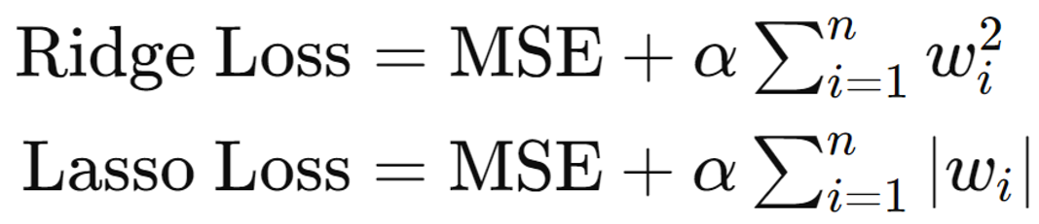

Ridge Regression
A linear regression technique that is used to prevent overfitting in OLS linear regression modeling
The objective of Ridge regression is to find the coefficient vector (w) that minimizes
a (alpha) is the regularization parameter or penalty term, which controls the strength of the regularization. Higher values of a result in more regularization (shrinking w)
By penalizing the magnitude of the coefficients, Ridge regression helps to stabilize the model and improve its generalization performance on unseen data
계수 크기에 제한주기
0이 될수 없는 이유 : a가 무한대가 되어야함
OLS Loss
L2 Loss

Slide 42
Lasso Regression (Least Absolute Shrinkage and Selection Operator)
A linear regression technique that, similar to Ridge regression, is used to prevent overfitting in OLS linear regression modeling
The objective of Lasso regression is to find the coefficient vector (w) that minimizes
A (alpha) is the regularization parameter or penalty term, which controls the strength of the regularization. Higher values of a result in more regularization
This penalty term encourages sparsity in the coefficient vector by penalizing coefficients with large magnitudes, effectively driving some coefficients to exactly zero (feature selection)
절대값 함수기 때문에 0으로 만들어버릴수있다..?
OLS Loss
L1 Loss

Slide 43
Ridge vs. Lasso
Ridge Regression
Ridge regression cannot eliminate any independent variables
It tends to perform well when the explanatory power of these independent variables is relatively similar.
Lasso Regression
Lasso regression has the ability to eliminate certain independent variables
It performs effectively when some independent variables have high explanatory power while others have low explanatory power.

Slide 44
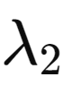
ElasticNet Regression
A linear regression technique that combines the properties of Ridge regression and Lasso regression
The objective of ElasticNet regression is to find the coefficient vector (w) that minimizes
By incorporating both types of penalties, ElasticNet regression is able to handle multicollinearity, perform variable selection, and control model complexity more effectively compared to using Ridge or Lasso regression alone
OLS Loss (RSS)
L1 Loss
L2 Loss

Slide 45

Bias-Variance Trade-off
Bias-Variance Trade-off
The balance between a model's complexity and accuracy
It is crucial to find the right balance of model complexity that minimizes both bias and variance, ultimately leading to the best predictive performance in general
Bias
Variance
Scott Fortmann-Roe, "Understanding the Bias-Variance Tradeoff", 2012
Notes:
in Ridge regression, the larger the ridge alpha parameter, the higher the bias and the lower the variance.

Slide 46
Bias-Variance Trade-off
Bias
Bias measures how much a model's predictions deviate from the true values on average across different datasets
High bias occurs when a model is too simple, leading to underfitting
Variance
Variance measures how much the predictions of a model vary for different datasets
High variance occurs when a model is too complex or flexible, leading to overfitting
Scott Fortmann-Roe, "Understanding the Bias-Variance Tradeoff", 2012
Notes:
in Ridge regression, the larger the ridge alpha parameter, the higher the bias and the lower the variance.

Slide 47
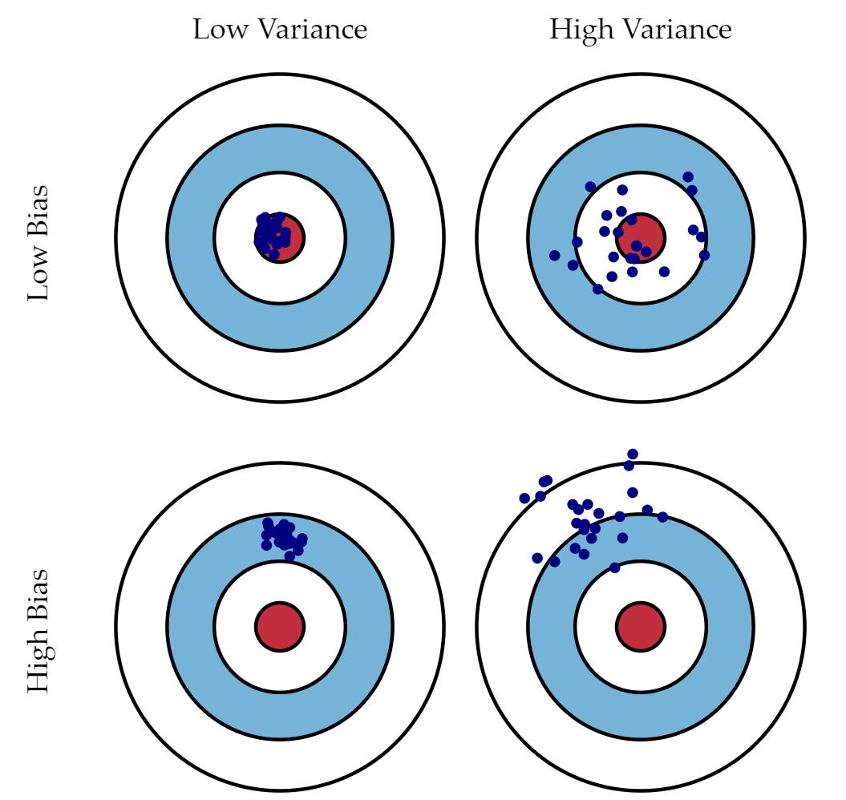
Bias-Variance Trade-off
Scott Fortmann-Roe, "Understanding the Bias-Variance Tradeoff", 2012
Notes:
in Ridge regression, the larger the ridge alpha parameter, the higher the bias and the lower the variance.

Slide 48
Assumptions of Linear Regressions
Linearity | 선형성
The relationship between the independent variables and the dependent variable should be linear
Independence | 독립성
There is no correlation between errors (residuals)
The errors (residuals) should be independent of each other
Homoscedasticity | 등분산성
The variance of the errors (residuals) should be constant across all levels of the independent variables
Normality | 정규성
The errors (residuals) should be normally distributed

Slide 49
Limitations of Linear Regressions
Sensitivity to outliers
the linear regression model uses the OLS model to estimate the coefficients. So, any observation that is away from the major cluster of points will have a squared impact, leading to biased results.
Prone to underfitting
Underfitting occurs when a model cannot adequately capture the underlying structure of the data
Overfitting of complex models
Contrary to underfitting, overfitting happens when the model fits the data too well, sometimes capturing the noise too. this usually happens when the model is too complex with many parameters, and the data is too less.

Slide 50
Appendix | Data Scientist Interview Questions
Airbnb
Say you are running a simple logistic regression to solve a problem but find the results to be unsatisfactory. What are some ways you might improve your model, or what other models might you look into using instead? (from Huo and Singh, Ace the data science interview, 2022)
Google
Can you discuss your experience with LASSO RIDGE research papers and optimization?
"The actual questions were pretty tough. Most were more statistical than programming-based. They were interested in my understanding of parameter estimation for click through rate problems and also my knowledge of linear models with and without regularization (i.e., Lasso and Ridge regression)" Senior Data Scientist Interview at Google, 2019

Slide 51
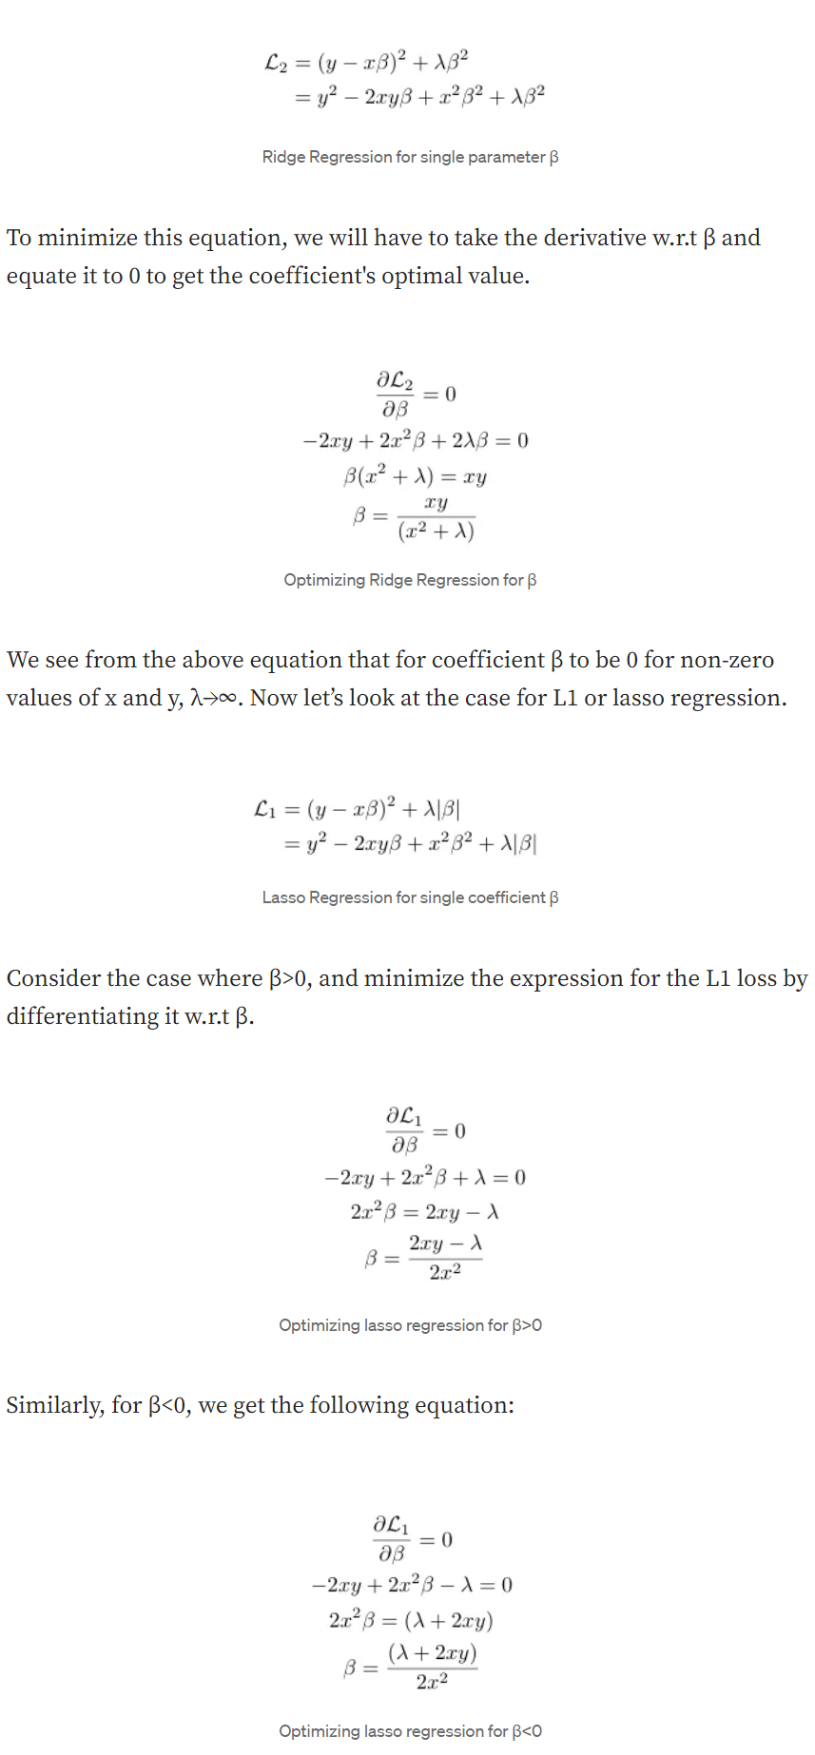
Appendix |Why coefficients cannot be 0 in Ridge
https://medium.com/@mukulranjan/how-does-lasso-regression-l1-encourage-zero-coefficients-but-not-the-l2-20e4893cba5d

Slide 52

Appendix |Why coefficients can be 0 in Lasso
https://medium.com/@mukulranjan/how-does-lasso-regression-l1-encourage-zero-coefficients-but-not-the-l2-20e4893cba5d

